Slide 1

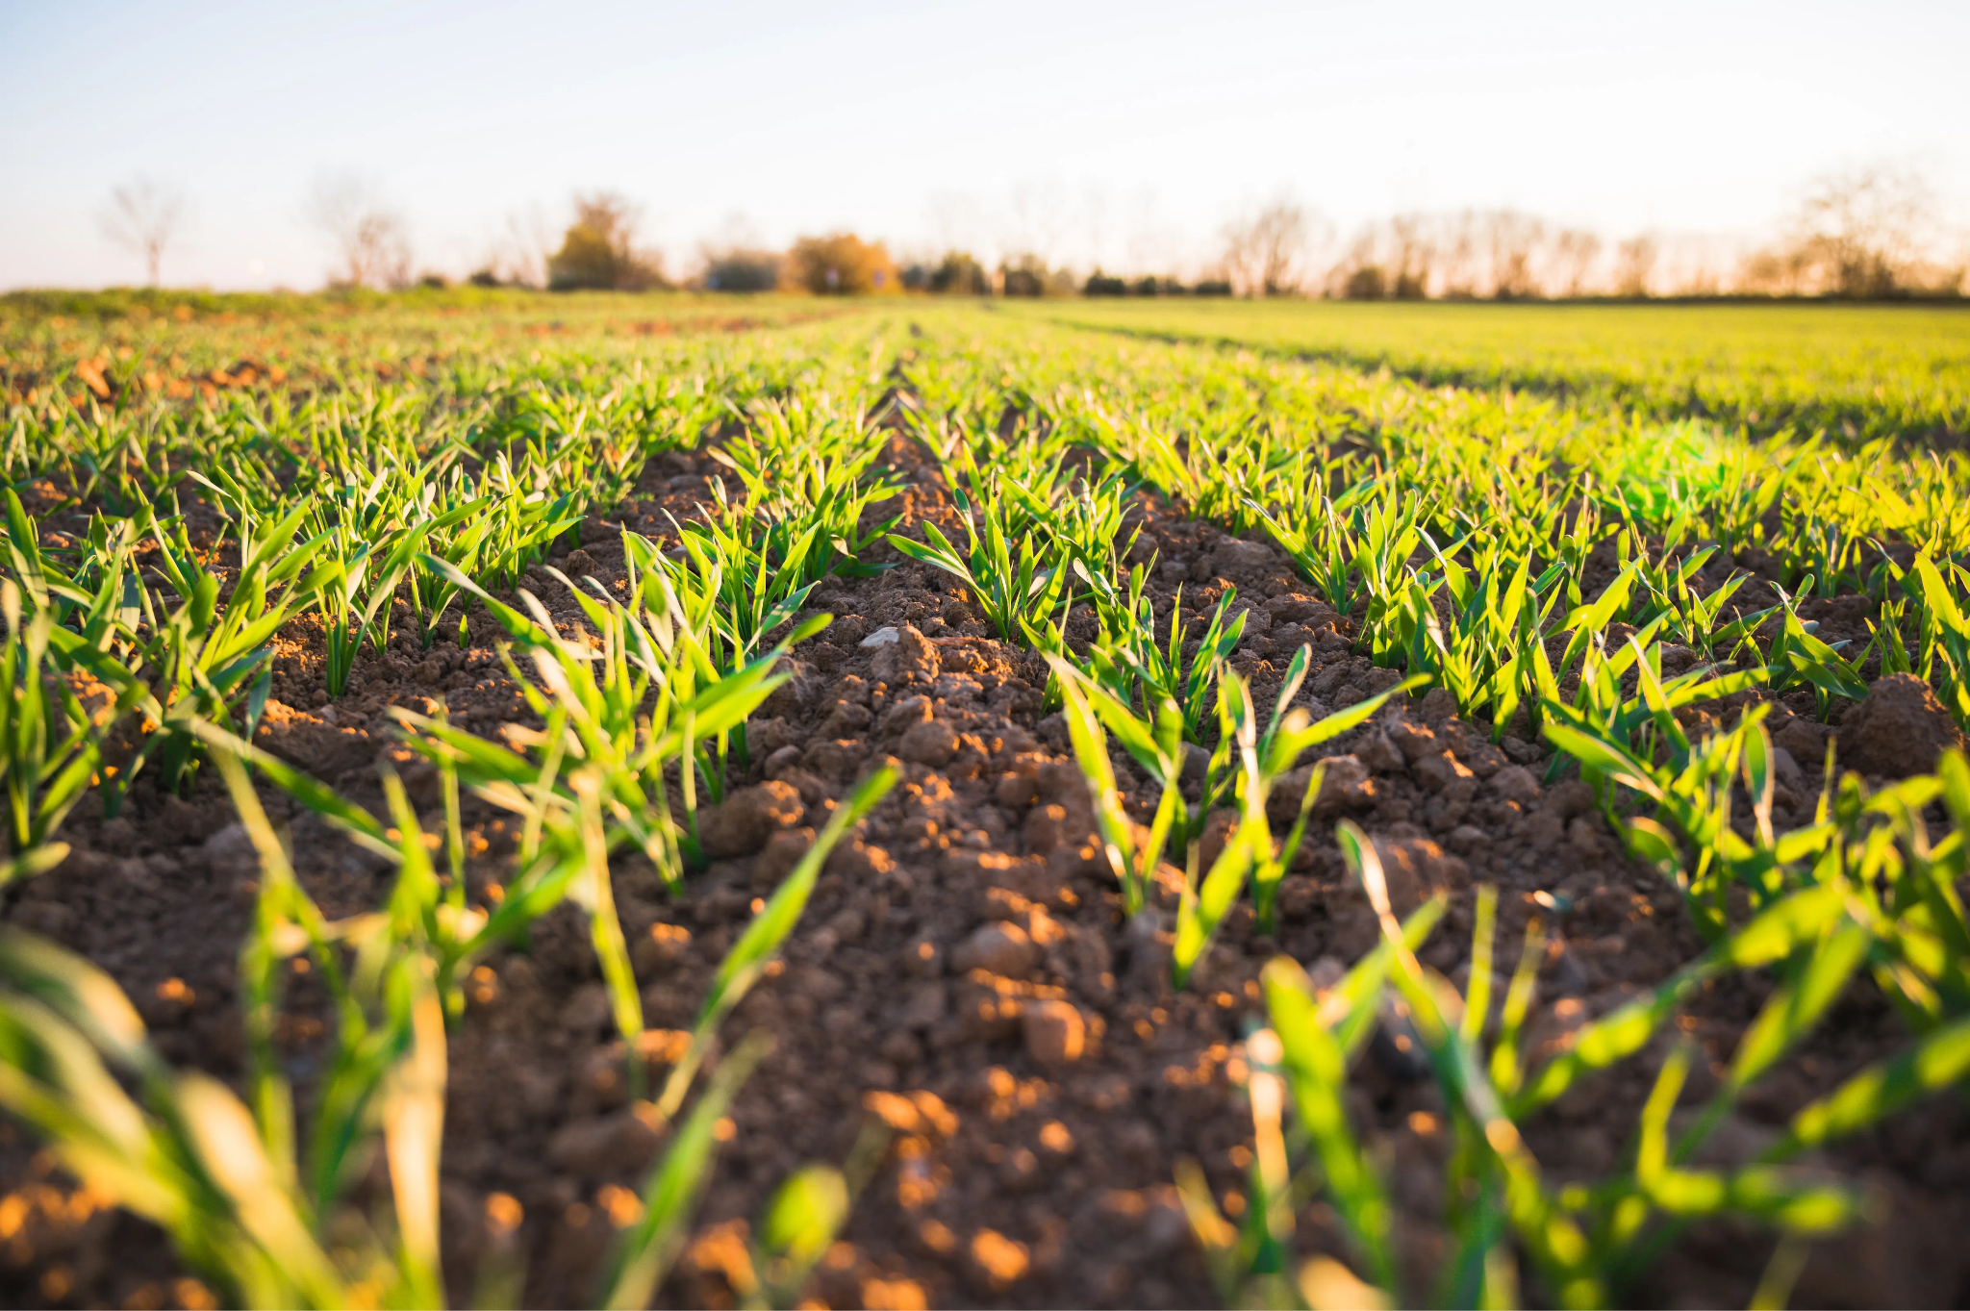
Santa’s Workshop Schedule Optimization
Plant Disease Recognition
ADSP 31009 IP01
John Fitzgerald
Rithik Alluri
Kevin Ko
ADSP 32013 Team 10
Bianca Gunawan, Jacky Lin, Sally Lee, Kevin Ko

Slide 2


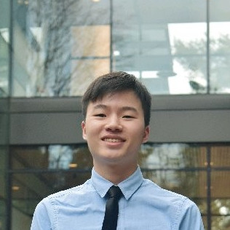
Our Team
John Fitzgerald
Rithik Alluri
Kevin Ko

Slide 3
Agenda
Business Problem
Data Overview
Problem Approach
Testing & Validation
Results & Limitations

Slide 4
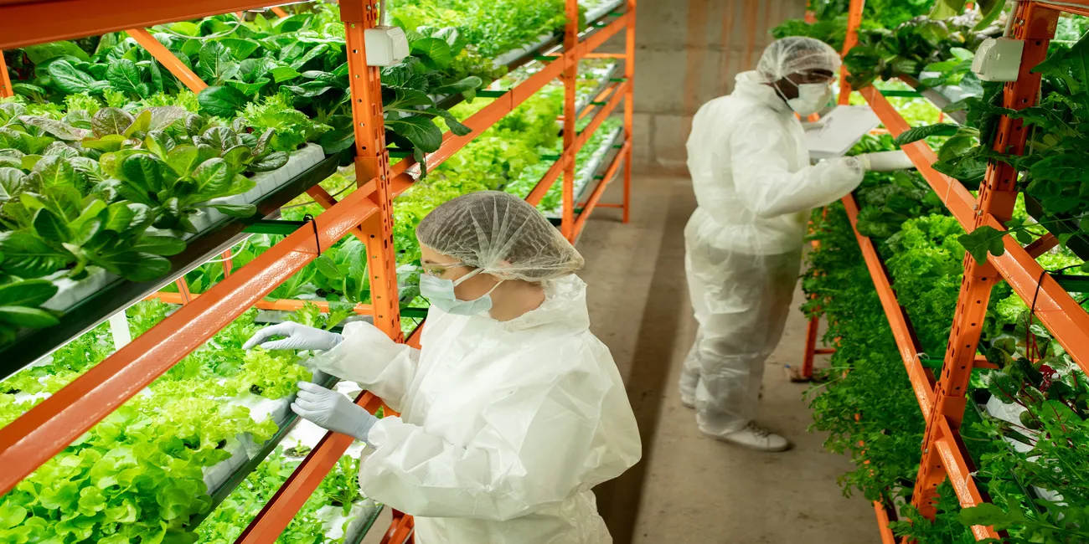
Business Problem
Plant Disease Recognition System to Achieve High Yield and Efficient Production
Business Problem
Data Overview
Problem Approach
Testing & Validation
Results & Limitations
Plant infections significantly impact both crop quality and quantity. Early prediction and recognition of these infections are vital to prevent crop damage and enhance yield.
Infestations cause a 30-33% annual decrease in productivity. This economic cost is $220 billion/year globally (NIFA, 2023)
Challenges in Traditional Practices:
Farmers rely on visual inspection and personal expertise
Undetected infections can lead to significant yield loss
Inconspicuous symptoms make disease identification difficult
Opportunity through ML Practices:
ML plant disease recognition system provide fast and accurate outcomes through computerized detections and image processing, reduce labor costs, time inefficiencies, and enhance crop quality and yield
Notes:
1. https://www.nifa.usda.gov/about-nifa/blogs/researchers-helping-protect-crops-pests#:~:text=Each%20year%2C%20plant%20diseases%20cost,Organization%20of%20the%20United%20Nations.

Slide 5
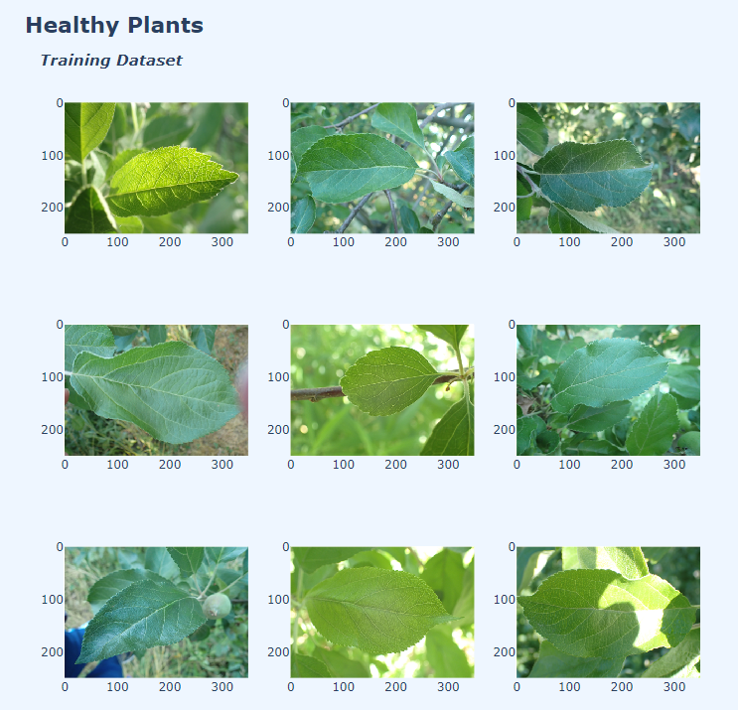
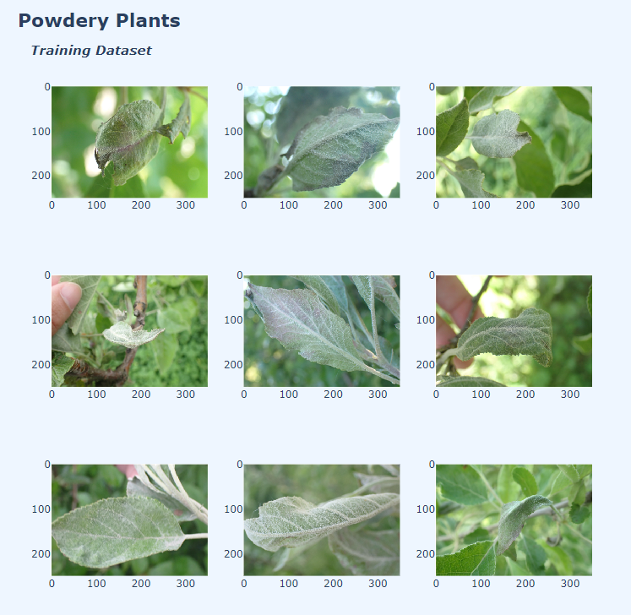
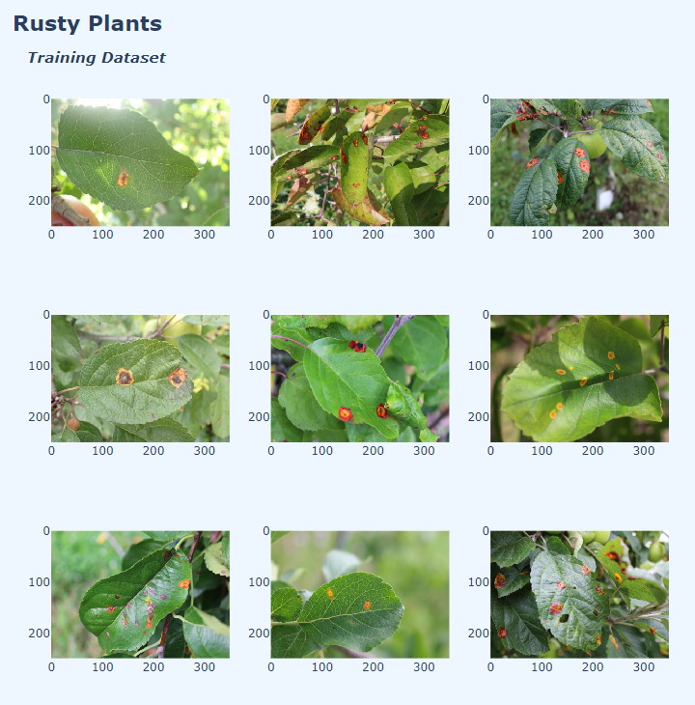
Data Overview
Data contains Images on Three Groups of Leaves - Healthy, Powdery, and Rust.
Business Problem
Data Overview
Problem Approach
Testing & Validation
Results & Limitations
Source: https://www.kaggle.com/datasets/rashikrahmanpritom/plant-disease-recognition-dataset
Notes:
Data Source: https://www.kaggle.com/datasets/rashikrahmanpritom/plant-disease-recognition-dataset

Slide 6
Data Overview
Data contains Images on Three Groups of Leaves - Healthy, Powdery, and Rust.
Business Problem
Data Overview
Problem Approach
Testing & Validation
Results & Limitations
There are a total of 1530 images divided into train, test, and validation sets.
Data Definition | Data Source | Data Size | No. Images
Test | Kaggle | 128.3 MB | 155
Train | Kaggle | 1.17 GB | 1325
Validation | Kaggle | 55.3 MB | 65
Notes:
Data Source: https://www.kaggle.com/datasets/rashikrahmanpritom/plant-disease-recognition-dataset

Slide 7

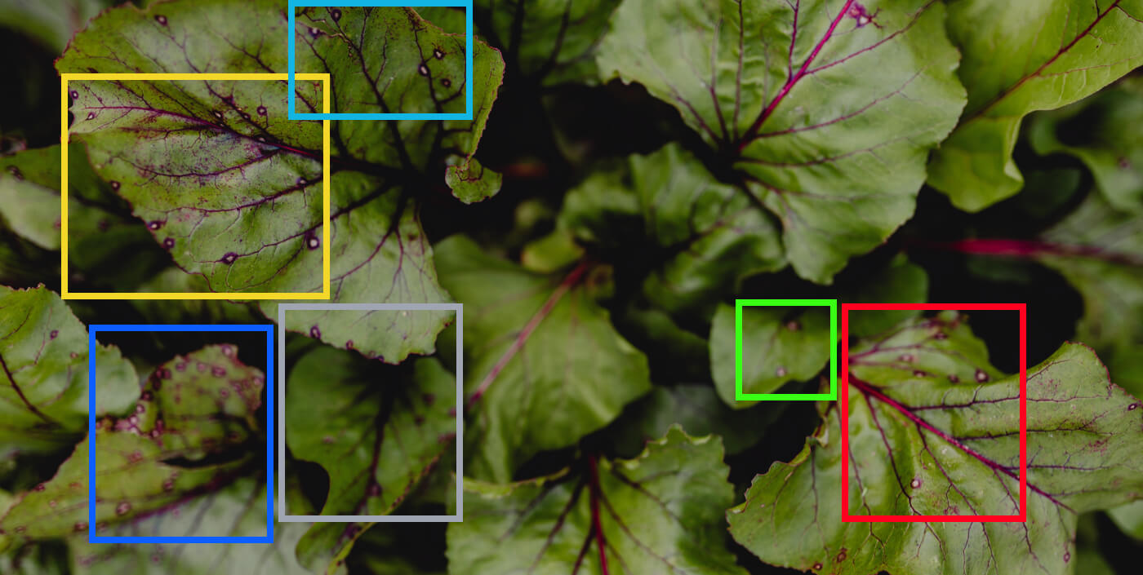
Problem Approach
Methods - Convolutional Neural Network
Business Problem
Data Overview
Problem Approach
Testing & Validation
Results & Limitations
Notes:
A convolution layer applies multiple filters and a loss function to the input data to compute a rectified linear unit function (transform feature map and introduce nonlinearnality) extract and learn spatial features and patterns from images
The pooling layer reduces the dimensionality of our input by taking average values from smaller sub-regions, to prevent overfitting.
The Fully connected layer connects every neuron in the previous layer to every neuron in the next layer, to classify the leaves based on their features.

Slide 8
CNN Models
Increasing the number of convolutional layers, and decreasing neurons in dense layer led to highest accuracy model
Business Problem
Data Overview
Problem Approach
Testing & Validation
Results & Limitations
Architecture | Validation Set Accuracy | Validation Set Loss | Test Set Accuracy | Test Set Loss
3 convolutional layers (64, 128, 256 filters) with ‘relu’ activation Dense layer with 256 neurons | 0.783 | 0.937 | 0.833 | 0.443
3 convolutional layers (64, 128, 256 filters) with ‘relu’ activation Dense layer with 64 neurons | 0.850 | 0.421 | 0.867 | 0.332
4 convolutional layers (64, 128, 256, 512 filters) with ‘relu’ activation Dense layer with 64 neurons | 0.950 | 0.175 | 0.933 | 0.246
Notes:
Increasing the Number of Convolutional Layers
Feature Extraction:
More convolutional layers allow the network to learn more complex and abstract features from the input images. Early layers might learn simple features like edges and textures, while deeper layers can capture more complex patterns and objects.
Receptive Field:
Each additional convolutional layer increases the receptive field of the neurons, meaning each neuron can "see" a larger portion of the input image. This helps in capturing more context and spatial hierarchies.
Hierarchical Representations:
With more convolutional layers, the network can build a hierarchy of features, which improves its ability to understand and classify images based on intricate patterns.
Computational Cost and Memory Usage:
Adding more convolutional layers increases the computational cost and memory requirements during training and inference. This might necessitate more powerful hardware or longer training times.
Potential for Overfitting:
Although more convolutional layers can improve feature extraction, they also increase the risk of overfitting, especially if the dataset is not large enough. Regularization techniques like dropout, data augmentation, and batch normalization can help mitigate this risk.
Decreasing the Number of Neurons in the Dense Layer
Model Complexity:
Fewer neurons in the dense layer reduce the overall complexity of the model. This can be beneficial in preventing overfitting, especially if the model has a large number of parameters in the earlier convolutional layers.
Computational Efficiency:
Dense layers are often the most computationally expensive part of a CNN because they have many parameters. Reducing the number of neurons decreases the number of parameters, making the model more efficient and faster to train and run.
Representation Power:
While dense layers are crucial for combining and interpreting the features extracted by convolutional layers, reducing their size might limit the model’s ability to learn complex decision boundaries. However, if the convolutional layers are sufficiently deep and effective, a smaller dense layer can still perform well.
Overfitting:
Fewer neurons in the dense layer can reduce the risk of overfitting by decreasing the model’s capacity to memorize the training data, forcing it to learn more generalizable features.

Slide 9
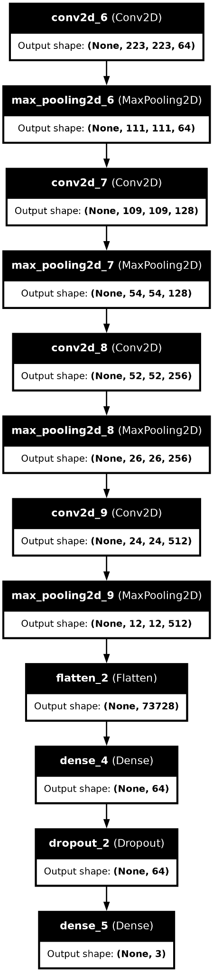
Final Model Architecture
Business Problem
Data Overview
Problem Approach
Testing & Validation
Results & Limitations
Model Features:
Four convolutional / max-pooling layers with a ‘relu’ activation function with a final feature map of dimensions 12x12x512
One flatten layer to convert feature map to a 1D vector for dense layers
One dense fully connected layer with 64 neurons and ‘relu’ activation to learn complex / non-linear combinations of features
One dropout layer to prevent overfitting
One dense layer with 3 neurons for the number of classes

Slide 10
Model Compilation
Business Problem
Data Overview
Problem Approach
Testing & Validation
Results & Limitations
optimizer = ‘Adam’ → computes individual adaptive learning rates for different parameters from estimates of first and second moments of the gradients
loss = ‘categorical_crossentropy’ → loss function for multi-class classification
EarlyStopping: Used to stop the training process if the monitored metric - validation loss - does not improve after 3 epochs.
To prevent overfitting and save computational resources by stopping training when further improvements are unlikely.
epochs=10: Iterate over the entire training dataset 10 times
batch_size=16: Use mini-batches of 16 samples each for each gradient update

Slide 11
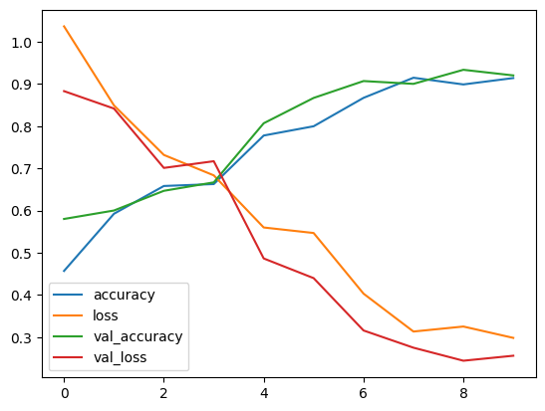
Testing & Validation
Trained Model Evaluation
Business Problem
Data Overview
Problem Approach
Testing & Validation
Results & Limitations
# of Epochs

Slide 12
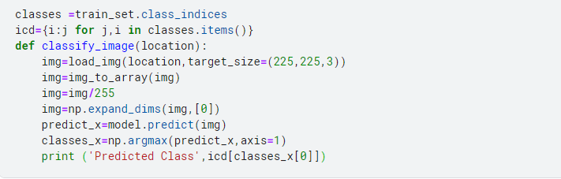
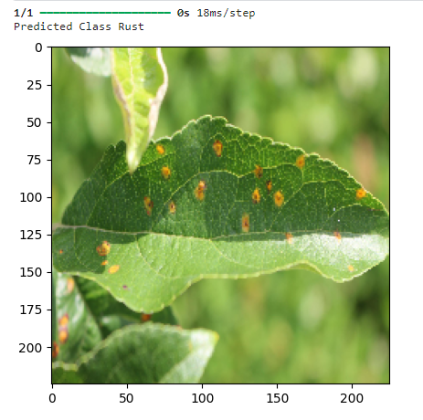
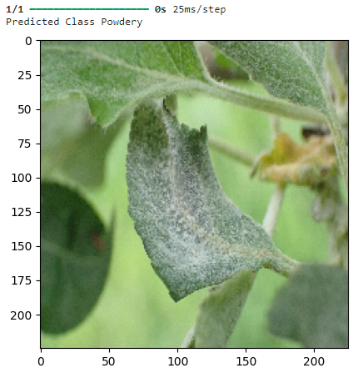
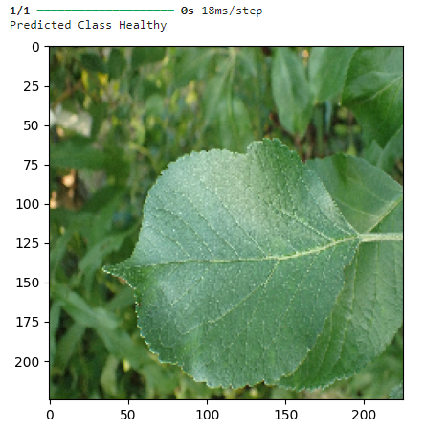
Prediction
Business Problem
Data Overview
Problem Approach
Testing & Validation
Results & Limitations

Slide 13
Next Steps
Limitations, model efficiency improvements, and business value
Business Problem
Data Overview
Problem Approach
Testing & Validation
Results & Limitations
Next Steps
A
Further Cost Considerations
A high resolution camera could enable more accurate image classification.
The scalability of the project might be limited for a large field without high investments in the short term on things such as robotics.
B
Model Improvement
Environmental and device noises affects the leaf samples
Classification of severity of symptoms in the plant disease remains as an opportunity
C
Business Value
Our Model will allow farmers to yield better quality crops that fetch better prices, use less pesticides, reduce crop loss, and increase the competitiveness of farms in the market.

